Slide 1
Real-Time Electricity Data
Team 2064

Slide 2
Quick Guide
Find real-time data sources
Alberta Electric System Operator
IESO-Ontario
Nova Scotia Power
Fetch real-time data from sources
Develop a web page to show the data

Slide 3
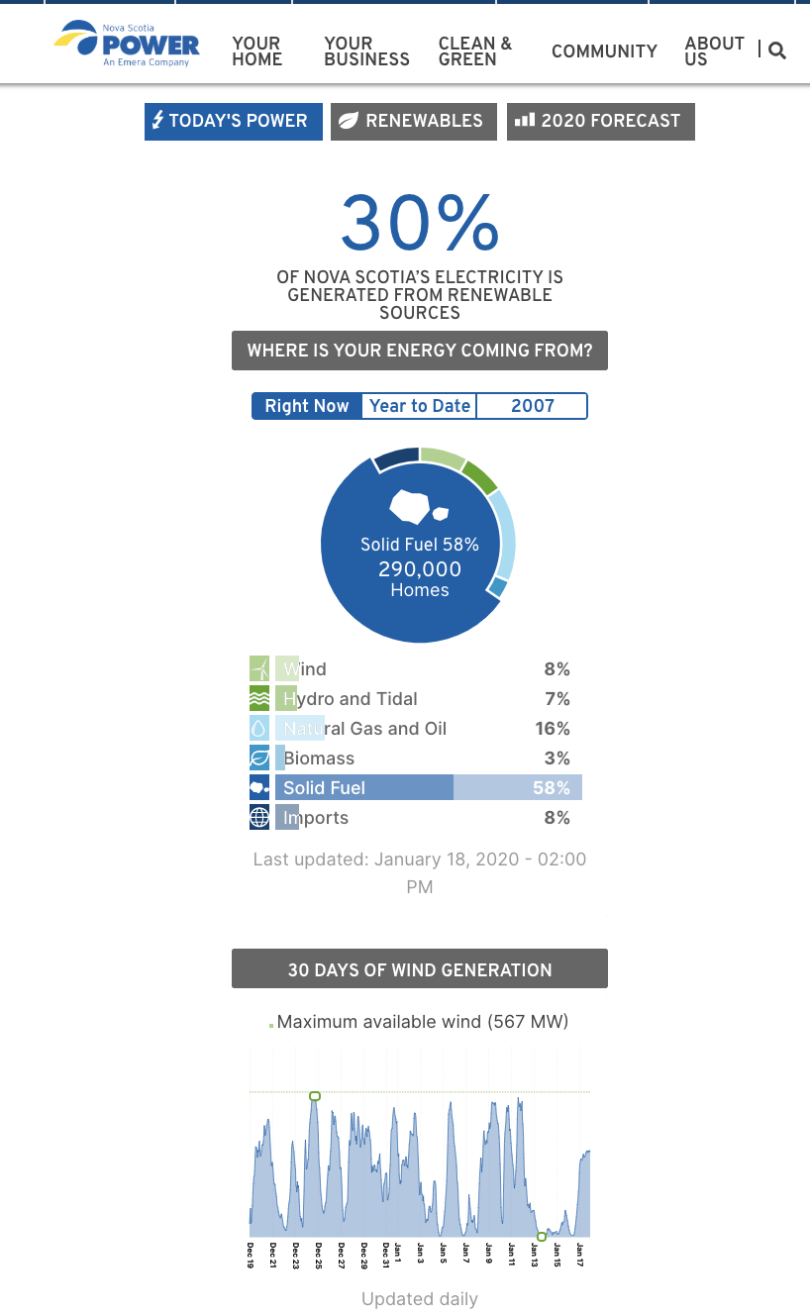
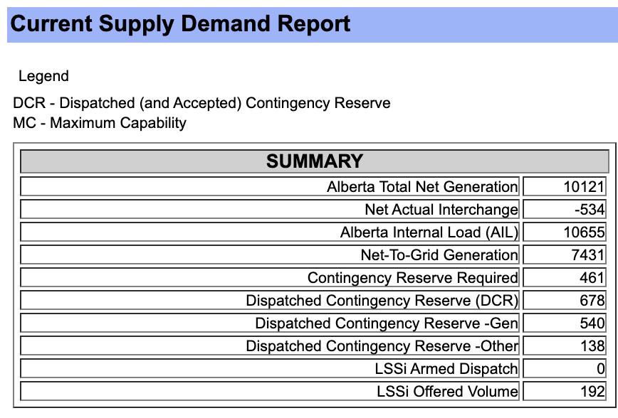
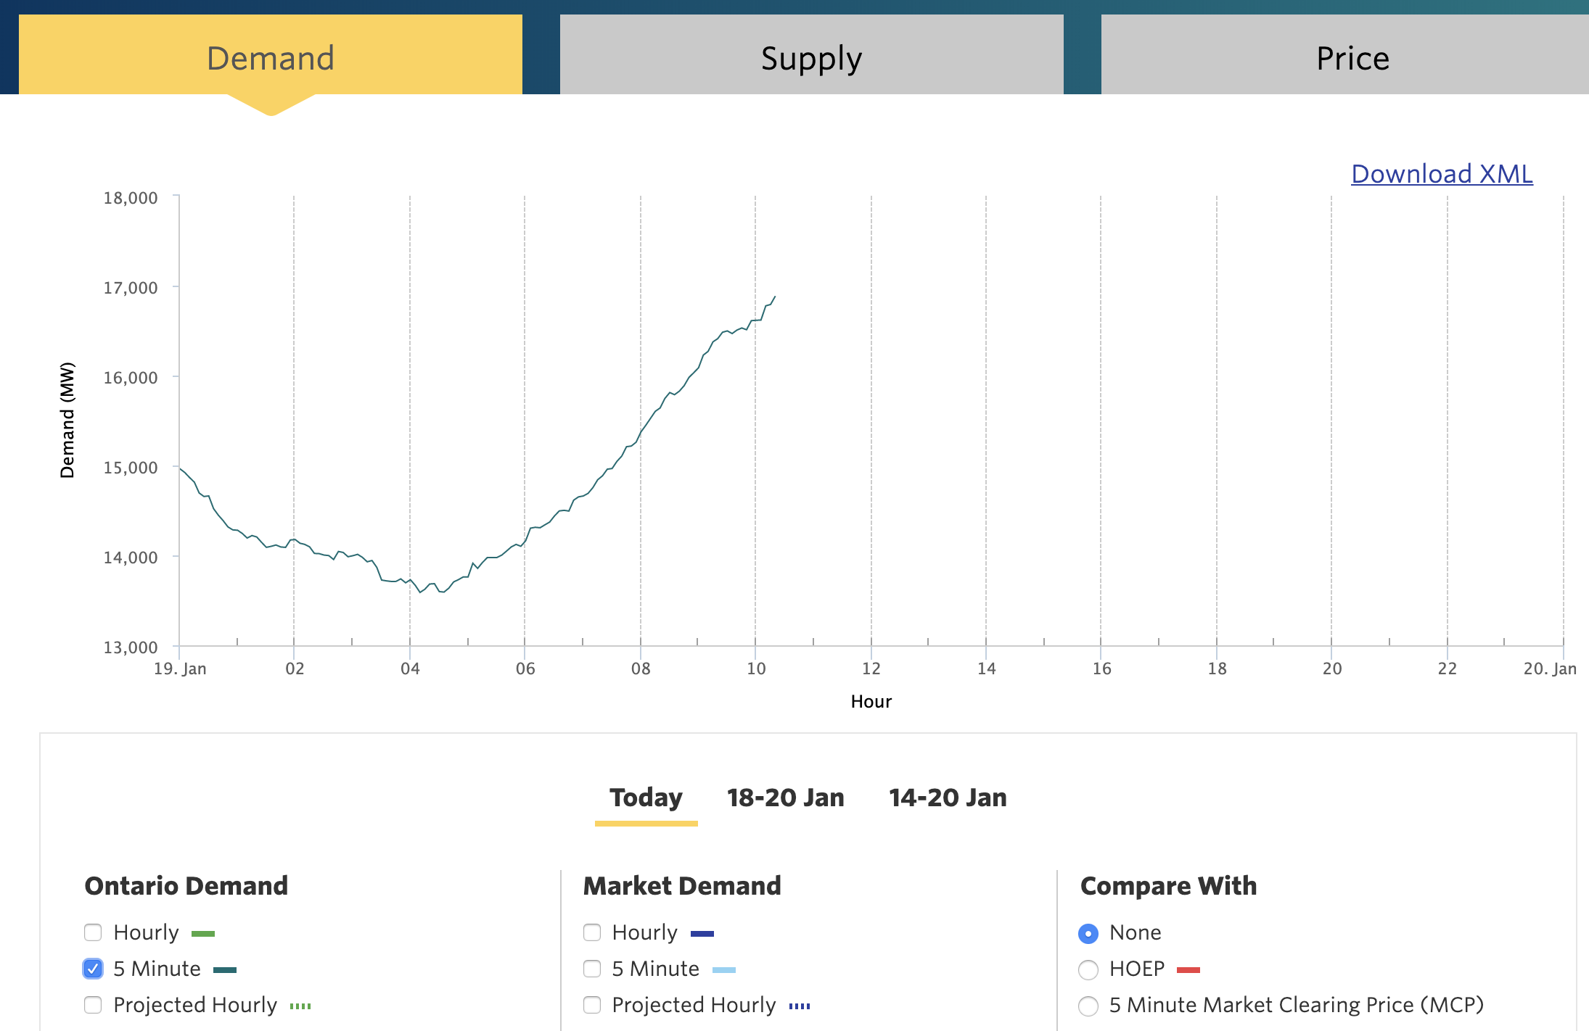
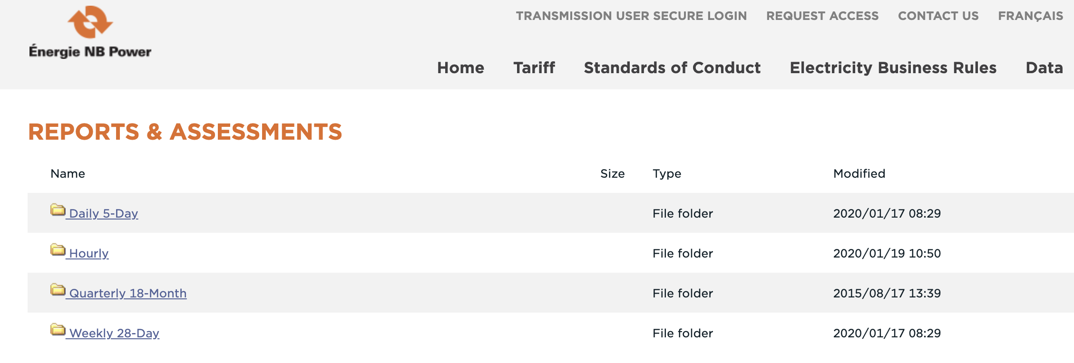
Find real-time data sources
All real-time source we found
Alberta: every 1min
Ontario: every 5min
Nova Scotia: every 1hour
New-Brunswick: every 1hour

Slide 4
Fetch real-time data
Our fetching system structure
The following shows the structure of our data processing system.
Alberta
Fetching every 30sec
Real-time data
In format:
”Province”
“Time (Latest)”
“Demand”
“Supply”
User Interface
Ontario
Fetching every 60sec
New Scotia
Fetching every 600sec
New-Brunswick
Fetching every 600sec

Slide 5
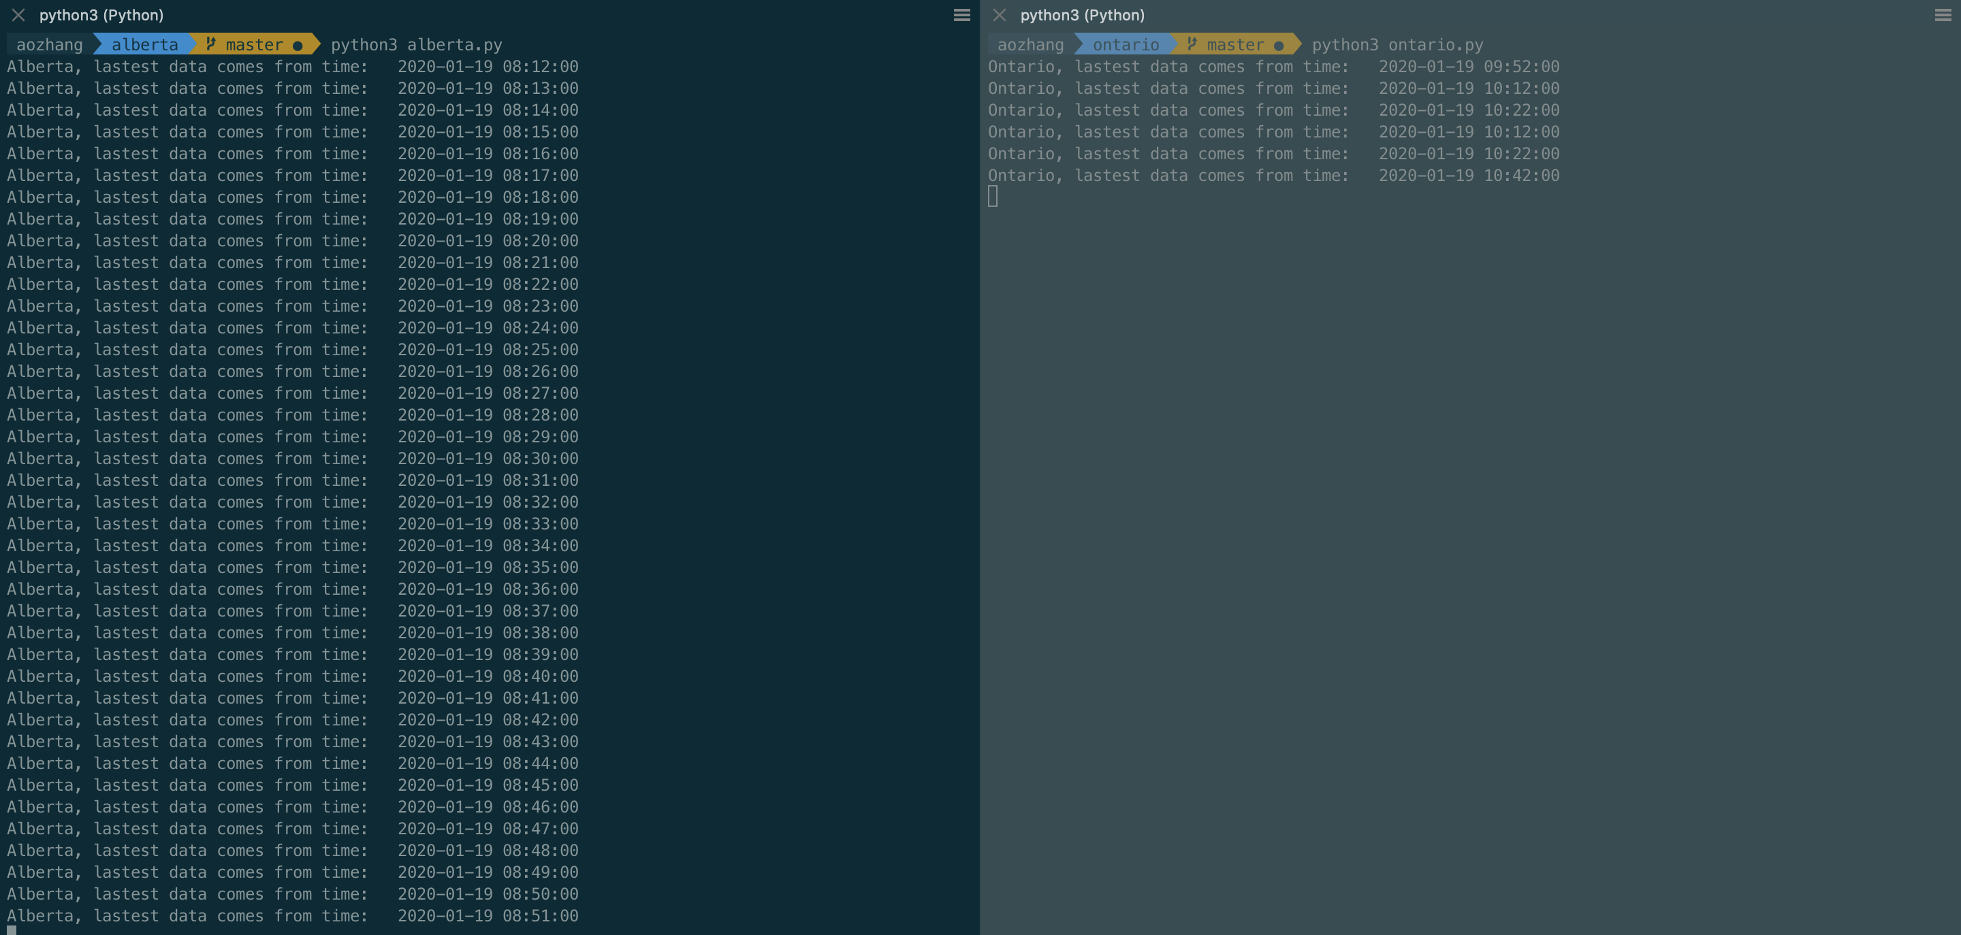
Fetch real-time data
Each province’s data is processed in one module
In order to inspect the data frequency, time stamp is printed out when running the script.

Slide 6
Develop UI
A map to choose from

Slide 7
Develop UI
Real-time data

Slide 8
Develop UI
Recorded data

